Slide 1
Retention of players
in the NBA Team for the upcoming years
Lavanya Telapudi

Slide 2
Abstract:
In the beginning of the NBA season, the cavalcade of predictions, projections and presumptions changed their way through the door, and they play an important role throughout the tournament.
So, in our project
I’m analyzing performance of every player from 1997 to 2022 based on the points they scored
Predicting whether a player is going to retain in the next season or not.
Since predictions of various events are important, our research would investigate whether machine learning algorithms are efficient in doing prediction on certain NBA data sets and tasks.

Slide 3
Introduction: Data Science and NBA
Data Science and Data Analytics has completely changed the NBA landscape, so much so that the league now runs a yearly Hackathon, this allows to get some great ideas and find new data analyst with talent.
How data is collected from an ongoing match? In 2009 the league began using a state of art video system to track the players movement on the court as well as the ball.
NBA’s data revolution has created rosters with more skilled, more well rounded players that are better rested, and increased the profitability of the NBA.

Slide 4
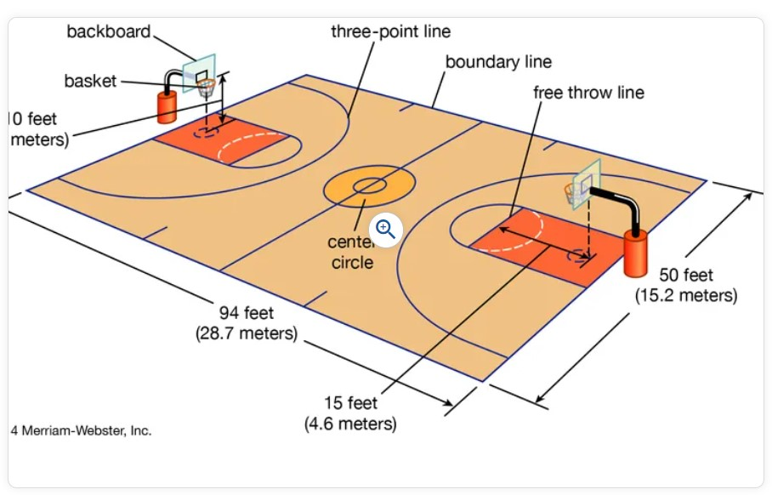
Basic Terminology

Slide 5
Introduction: Basic Terminology
Court game between two teams of five players.
They score by tossing, or “shooting,” an inflated ball through a raised hoop, or “basket,” located in their opponent’s end of the court.
A goal is worth two points, three if shot from outside a specified limit.
A player who is fouled (through unwarranted physical contact) by another is awarded one to three free-throw attempts (depending on the circumstances of the foul).

Slide 6
Introduction: Basic Terminology

Slide 7
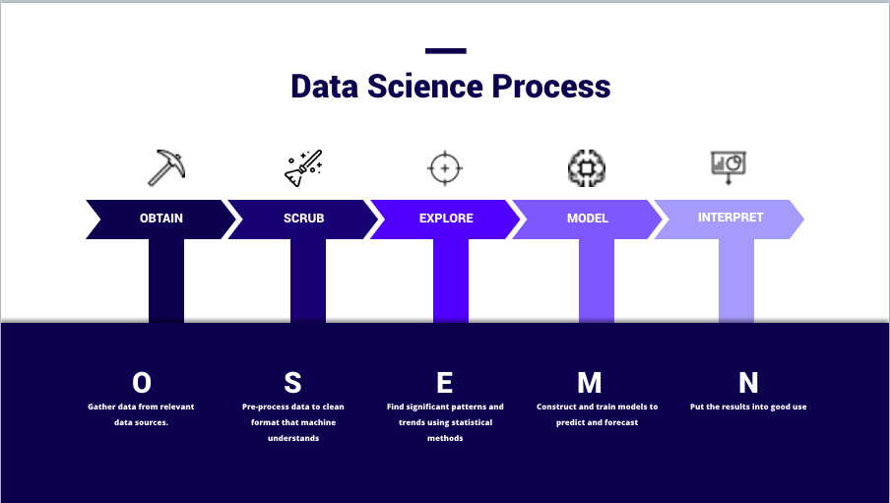
Workflow of the Project

Slide 8
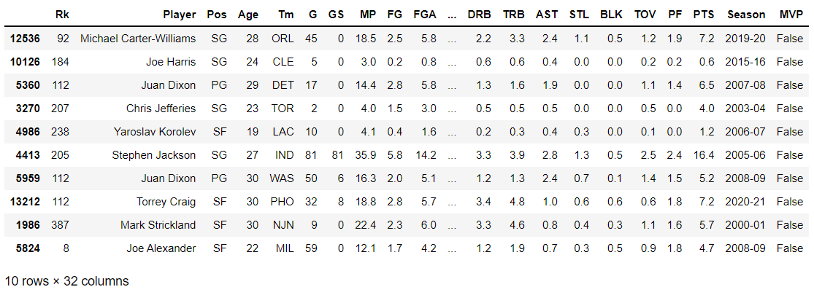
Obtaining the Dataset from csv file
Notes:
Dataset is obtained from Data.world
Target: PTS (continous variable)
Goal: Analyze if the player is going to be retained in next period

Slide 9
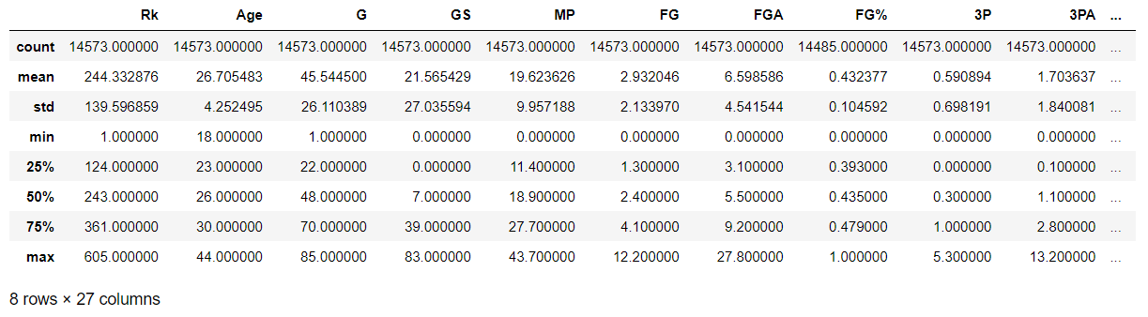
Summary Statistics
Notes:
Insights:
We can verify the presence of null values in column by looking at the count of each column. Evidently FG%, 3P% etc have null values present in it.
Maximum length of a basketball game is 43 minutes (column MP).
Average age of players is 26 years.
On an average a players score 7.8 point per game.
Maximum points made per game is 36 while minimum is zero.
Maximum number of games played by a player is 85 while the minimum is 1.

Slide 10
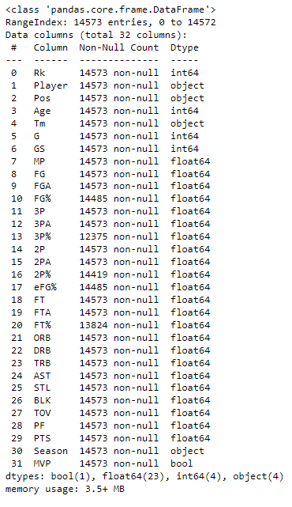
Features of the Dataset:
Name- Name of the player
GP-Games played
Min-Minutes played
Pts-Average points made per game
FGM- Field goals made
FGA-Field goals attempted
%FG-Percentage of field goals
3P MADE- Three-pointers made
3PA- Three-pointers attempted
FTM-Free throws made
FTA-Free throws attempted
FT%-Free throw percentage
OREB-Offensive rebounds
DREB-Defensive rebounds
Reb-Rebounds
AST-Assists
STL-Steals
BLK-Blocks
TOV-Turnovers
Notes:
Insights:
Type is DataFrame
Total number of Rows: 14573
Total number of Columns: 32
There are four data types: float64, int64, object, boolean
There are null values in some of the features like FG%, 3P% etc (we will explore null values later in the code)
The table has 23 columns. Most columns have a value for each of the rows (all 14573 values are non-null). Some columns do have missing values and less than 14573 non-null values.
Each row has a row label (aka the index) with values ranging from 0 to 14572.
The approximate amount of RAM used to hold the Data Frame is provided as well.

Slide 11
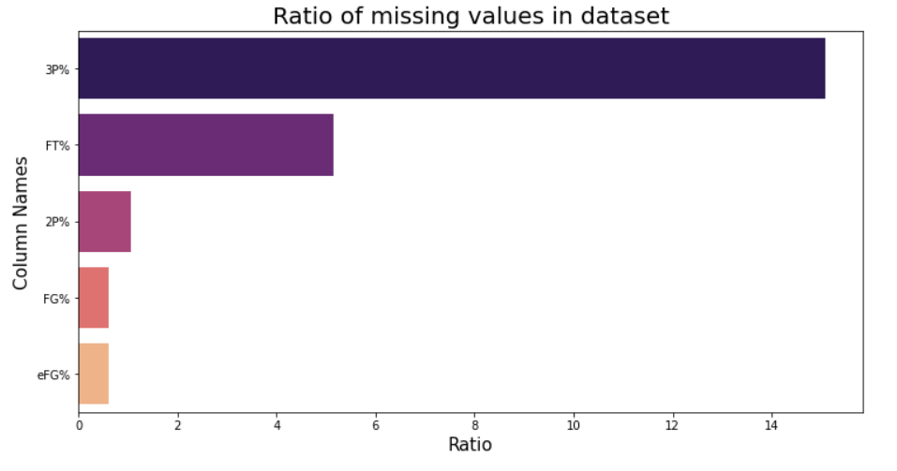
Analysing null values in the dataset:
Notes:
Evidently, out of 32 columns 5 columns contains missing values.
Treatment: Because these columns are associated with number of goals made or attempted, it is safe to replace these missing values with zero.

Slide 12
Exploratory Data Analysis (EDA):
Average Age, Min and Max
Average 2P, 3P and FT
Number of Teams
Which player scored the most points by season?
How many seasons?

Slide 13
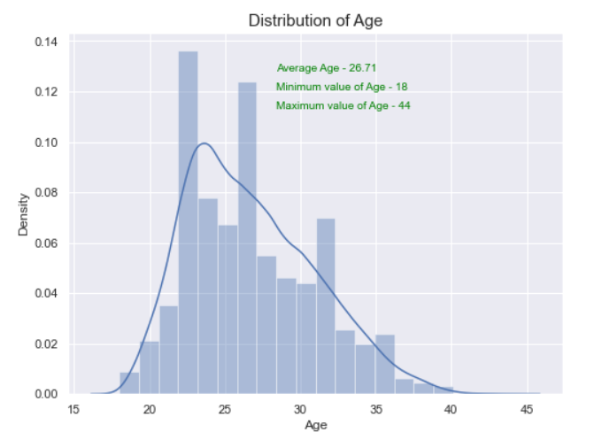
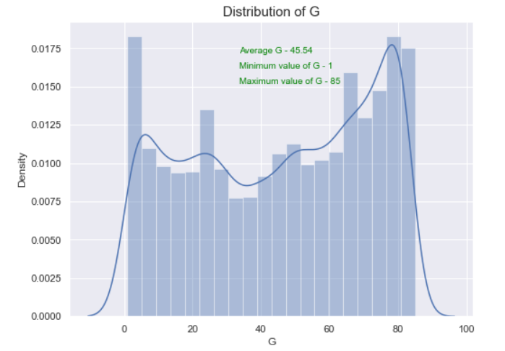
EDA: Distribution of Age and Games played

Slide 14
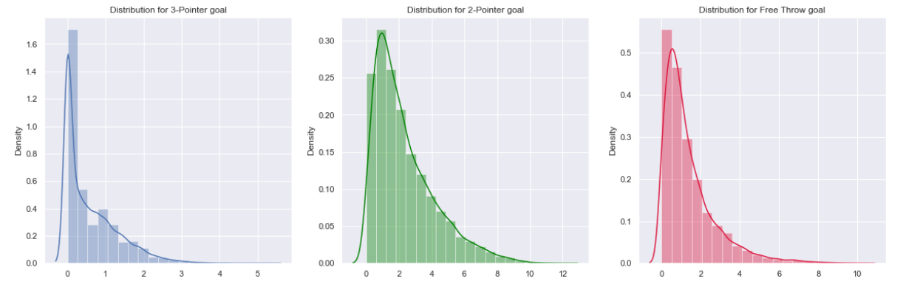
EDA: Distribution of Pointer Goals

Slide 15
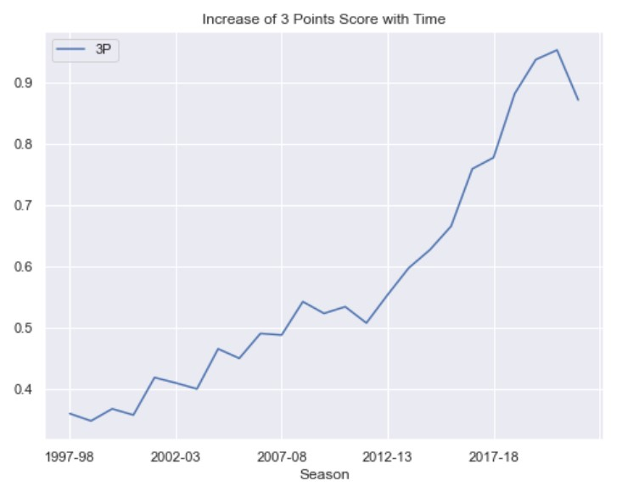
EDA: Increase of 3 Points Score with Time
Notes:
Jaspreet: It is quite evident with each season, shooting 3 Points have increased significantly.

Slide 16
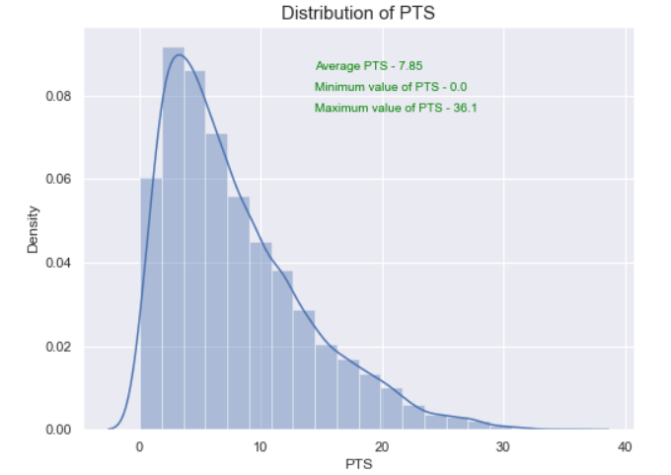
EDA: Average Points Made

Slide 17
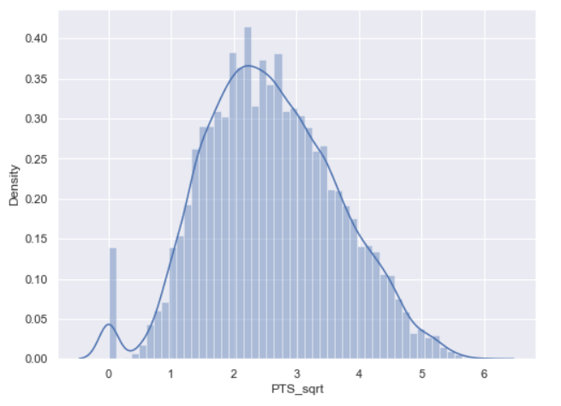
EDA: Square Root Transformation of PTS:
Notes:
To make the left squed

Slide 18
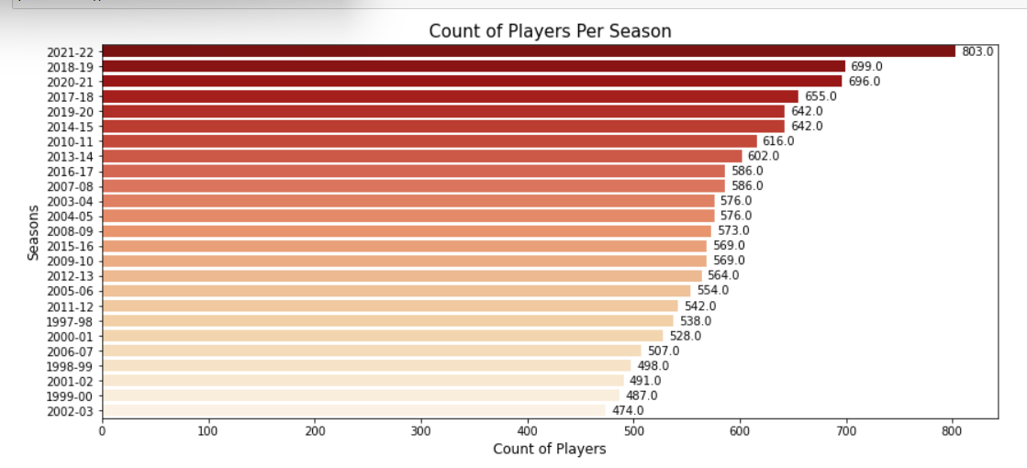
EDA: Count of Players per season

Slide 19
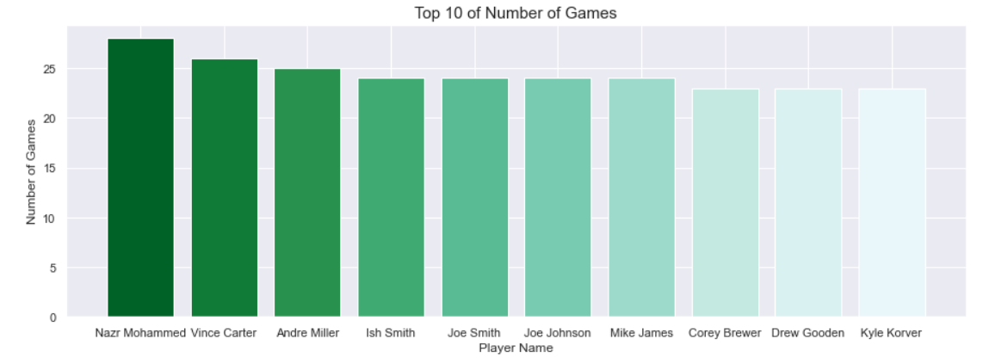
EDA: Top 10 of Number of Games

Slide 20
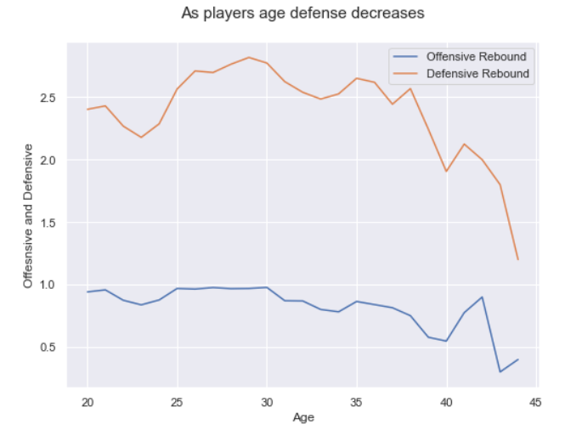
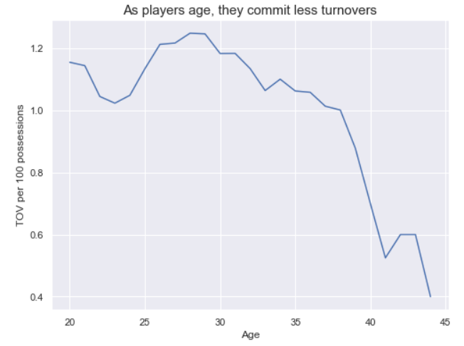
EDA: Age vs Efficiency
As players age, defense decreases
As players age, they commit less turnovers

Slide 21
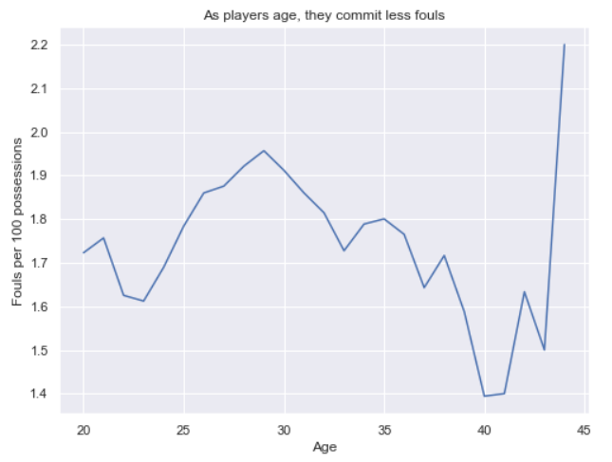
As players age, they commit less fouls

Slide 22
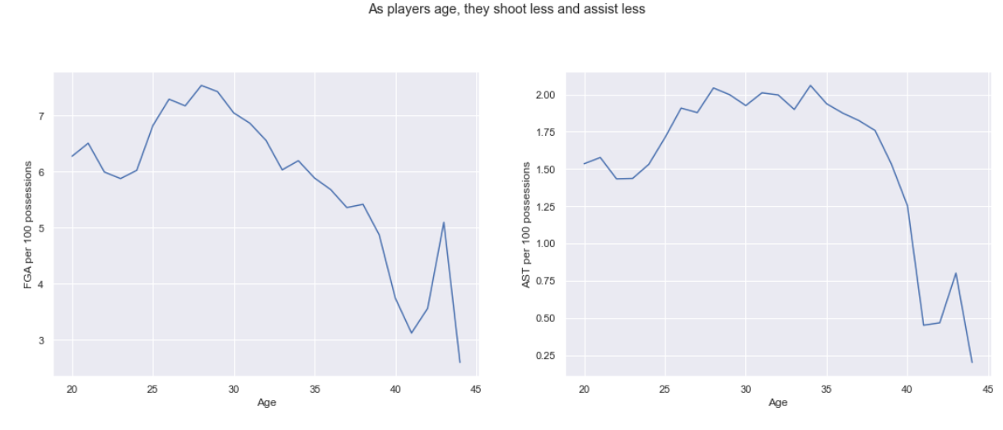
EDA: Age vs Efficiency
As players age, they shoot less and assist less

Slide 23
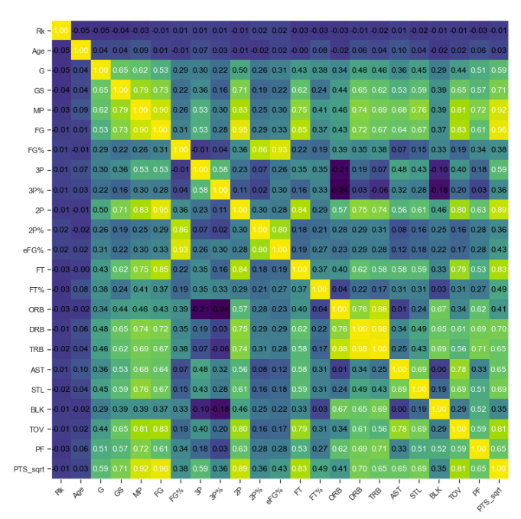
Heat Map:

Slide 24
Spearman Correlations:
Spearman correlation between PTS and FG is 0.9926
Spearman correlation between PTS and FGA is 0.9812
Spearman correlation between PTS and FG% is 0.3524
Spearman correlation between PTS and MP is 0.9346
Spearman correlation between PTS and 3P is 0.5549
Spearman correlation between PTS and 3PA is 0.54
Spearman correlation between PTS and 2P is 0.9176
Spearman correlation between PTS and 2PA is 0.9106
Spearman correlation between PTS and TOV is 0.8322
Spearman correlation between PTS and Age is 0.0573
Spearman correlation between PTS and G is 0.5973
Spearman correlation between PTS and GS is 0.761

Slide 25
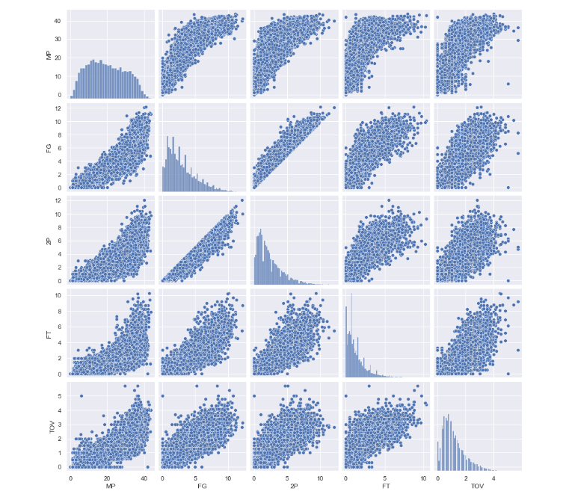

Slide 26
Intro to Data Modeling
1. Predicting number of assists(AST) per player from the field goals(FG)
i) Linear regression
2. Prediction of points(PTS). Six machine learning algorithms are put into usage: Linear regression, ridge, lasso, random forest, decision tree, gradient boosting regressor
3. Predicting whether a player is going to retain for the next season or not based on the dataset using Logistic regression, LDA, QDA, SVM,
GaussaNaiveBias.
Notes:
Coming to data modeling we were interested in doing three things
And fourth one is our main objective of the project

Slide 27
1. Predicting number of assists(AST) per player from the field goals(FG) they made.
As we saw positive correlation between the two columns AST and FG we wanted to predict that.
In this case we used a Linear Regression model to make our prediction.
After getting the predictions and the actual values the model doesn’t look to be approximating the values closely.

Slide 28
3.Prediction of points(PTS)
We used several supervised machine learning algorithms here
Here we took our features as 'MP', 'FG_sqrt', '2P_sqrt', 'FT_sqrt', 'TOV_sqrt' and target as ‘PTS_sqrt’ (points)
Linear regression:
Split the data set into 70% train data set and 30% test data set.
Fit the data into the model
Calculated R2 score for train and test data, is 95 percent approximately
And predicted the first 10 target values for the test dataset

Slide 29
2. Ridge regression
We used the same features and target for this too
Fit the data
R2 score is 96.3 percent for this regression
3. Lasso regression
R2 score for this regression is 97 percent
Printed coefficients of regression and found two of them to be 0. So, this regression can be used as a feature selection tool
And observed that this regression is in agreement with the results of spearman correlation analysis

Slide 30
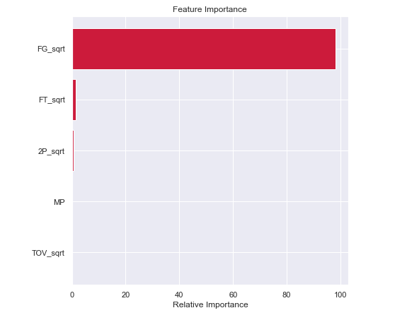
4. DecisionTreeRegressor
We used the same features and target and calculated the
Feature importance and found that ‘FG_sqrt’ is the most important feature than others

Slide 31
For the rest of the models we took only ‘FG_sqrt’ as our feature
Found the predictions of the tree regressor for train and test subsets and calculated R2 score
Used GridSearchCV to find the best hyperparameters
Retrained the regressor with the best hyperparameters and calculated the R2 score again and compared with the previous ones. We were successful in curing some variance by tuning the hyperparameters.

Slide 32
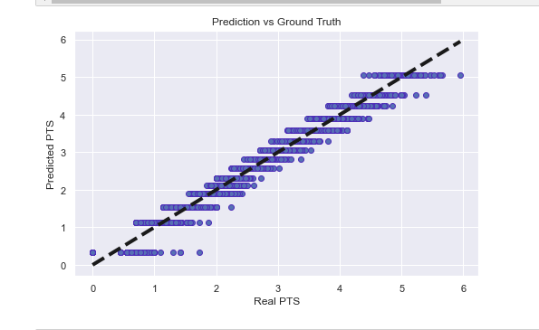
Plot predictions vs true values for ‘PTS_sqrt’
Notes:
Horizontal lines because that all those samples belong to the same region and this is how decision trees work

Slide 33
5. Gradient Boosting Regressor
98.18 percent R2 score and no overfitting
6. Random Forest Regressor
98 percent accuracy and no overfitting for this model

Slide 34
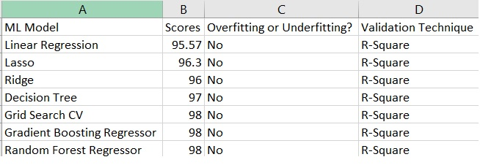
Conclusion for Regression Analysis:
Best ML Models: Decision Tree, Gradient Boosting Regressor, Random Forest Regressor produces same results.

Slide 35
4. Player will retain or not?
We took our features as ‘FG_sqrt’ and ‘FT_sqrt’ and
target as ‘Threshold PTS’
- This is a Balanced dataset
i) Logistic regression
Accuracy of 97%
No sign of overfitting

Slide 36
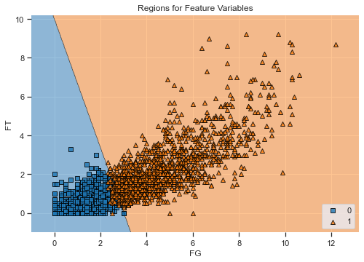
Decision Region for logistic regression

Slide 37
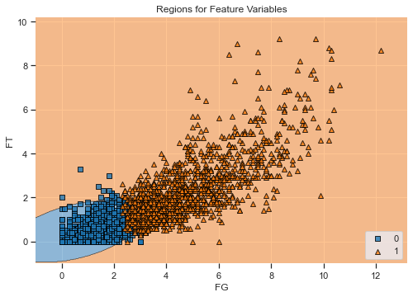
ii) LDA and QDA
Accuracy is 92 for LDA and 95 for QDA
No sign of overfitting

Slide 38

iii) Random forest classifier
Accuracy is 97
No sign of overfitting
iv) Gaussian naive bias
Accuracy is 94.5

Slide 39
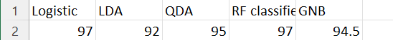
Conclusion
From the above we can say that Logistic regression and random forest classifier are the best to model our classification problem.

Slide 40
KMeans clustering
FUTURE SCOPE
A cluster refers to a collection of data points aggregated together because of certain similarities
Can make 5 clusters of players using this ML model to show which players are most similar to each other
We can see which players are in the same cluster and know some interesting facts from this

Slide 41
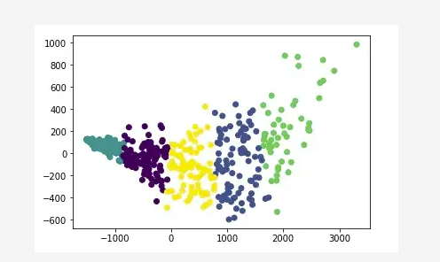
KMeans cluster of NBA Players where k=5

Slide 42
Thank you!

